Slide 1

Lecture 5 Data Modeling Using the Entity–Relationship (ER) Model

Slide 2
Agenda
Overview of Database Design Process
Example of Database Application (COMPANY)
Entities
Attributes
Relationships
Weak Entity
Final ER Diagram

Slide 3

Overview of Database Design Process

Slide 4
Overview of Database Design Process
Two main activities:
Database design
Applications design
Focus in this chapter on database design
To design the conceptual schema for a database
Applications design focuses on the programs and interfaces that access the database
Generally considered part of software engineering

Slide 5
Overview of Database Design Process
Purpose of ER Model:
The ER model allows us to sketch database designs.
Kinds of data and how they connect.
Not how data changes.
Designs are pictures called Entity-Relationship diagrams.
Later: convert ER designs to relational DB designs.

Slide 6
Example of Database Application (COMPANY)

Slide 7
COMPANY Database
We need to create a database schema design based on the following (simplified) requirements of the COMPANY Database:
Step # 1 : Requirements Collection & Data Analysis
The COMPANY database keeps track of:
employees and their dependents,
departments, and
projects
Database designers formulate a “Mini-world” Description

Slide 8
“Mini-world” Description
Concerning the Department:
company is organized into departments
a department has a unique name, a unique number, and a specific employee is its manager
we track the start date for the manager
a department may be in several locations
a department controls a number of projects
Concerning the Project:
a project has a unique name, a unique number, and is in a single location

Slide 9
“Mini-world” Description
Concerning the Employee:
each employee has a name, social insurance number, address, salary, gender, and birth date
an employee is assigned to one department but may work on several projects which are not necessarily controlled by the same department
we track the number of hours per week that an employee works on each project
we keep track of the direct supervisor of each employee
we track the dependents of each employee (for insurance purposes)

Slide 10
“Mini-world” Description
Concerning the Dependent
we record each dependent’s first name, gender, birth date, and relationship to the employee
Step # 2 : Build the database ER diagram (conceptual schema design):

Slide 11
Entities

Slide 12
Entities
Entities are specific objects or things in the mini-world that are represented in the database.
For example:
The EMPLOYEE John Smith,
The Research DEPARTMENT,
The ProductX PROJECT

Slide 13
Entity Type & Entity Set
Each Entity Type will have a collection of entities stored in the database
Called the Entity Set
Same name (EMPLOYEE) used to refer to both the entity type and the entity set
Entity set is the current state of the entities of that type that are stored in the database

Slide 14
Initial Design of Entity Types for the COMPANY Database Schema
Based on the requirements, we can identify four initial entity types in the COMPANY database:
DEPARTMENT
PROJECT
EMPLOYEE
DEPENDENT
Their initial design is shown on the following slide

Slide 15
Entities
In ER diagrams, an entity is displayed in a rectangular box
dependent
employee
project
department

Slide 16
Attributes

Slide 17
Attributes
Attributes are properties used to describe an entity.
For example:
an EMPLOYEE entity may have the attributes
Name, SSN, Address, Gender, BirthDate
A specific entity will have a value for each of its attributes.
For example:
a specific employee entity may have
Name='John Smith', SSN='123456789', Address ='731, Fondren, Houston, TX', Gender='M', BirthDate='09-JAN-55‘
Each attribute has a value set (or data type) associated with it – e.g. integer, string, subrange, …

Slide 18
Attributes
In ER diagrams, an attribute is displayed in an oval
fname
minit
lname
salary
dependent
name
gender
address
ssn
name
gender
birthdate
relationship
employee
bdate
degree
name
number
location
project
department
name
number
location
Number of Employees

Slide 19
Types of Attributes
Simple
Each entity has a single atomic value for the attribute. For example: SSN.
Composite
The attribute may be composed of several components. For example:
Address(Apt#, House#, Street, City, State, ZipCode, Country), or
Name(FirstName, MiddleName, LastName).
Composition may form a hierarchy where some components are themselves composite.
Multi-valued
An entity may have multiple values for that attribute. For example, PreviousDegrees of a STUDENT or Multiple Locations of a DEPARTMENT
Derived
Attributes do not exist in the physical database, but their values are derived from other attributes present in the database. For example, “Number of Employees”, should not be saved directly in the database, instead it can be derived.

Slide 20
Attributes
Composite
fname
minit
lname
salary
dependent
name
gender
address
ssn
name
gender
birthdate
relationship
employee
bdate
Multi-valued
name
number
location
project
department
name
number
location
Number of Employees
Derived
Simple

Slide 21
Complex Attributes
In general, composite and multi-valued attributes may be nested arbitrarily to any number of levels, although this is rare.
For example, PreviousDegrees of a STUDENT is a composite multi-valued attribute denoted by {PreviousDegrees (College, Year, Degree, Field)}
Multiple PreviousDegrees values can exist
Each has four subcomponent attributes:
College, Year, Degree, Field

Slide 22
Key Attributes
An attribute of an entity type for which each entity MUST have a Unique Value is called a key attribute of the entity type.
For example, SSN of EMPLOYEE.
A key attribute may be composite.
VehicleTagNumber is a key of the CAR entity type with components (Number, State).
An entity type may have more than one key.
Each key is underlined

Slide 23
Attributes
fname
minit
lname
salary
dependent
name
gender
address
ssn
name
gender
birthdate
relationship
employee
bdate
name
number
location
project
department
name
number
location
Number of Employees

Slide 24
Relationships

Slide 25
Refining the initial design by introducing relationships
The initial design is typically not complete
Some aspects in the requirements will be represented as relationships
ER model has three main concepts:
Entities (and their entity types and entity sets)
Attributes (simple, composite, multivalued)
Relationships (and their relationship types and relationship sets)
We introduce relationship concepts next

Slide 26
Relationships and Relationship Types
A relationship relates two or more distinct entities with a specific meaning. For example:
EMPLOYEE John Smith works on ProductX PROJECT,
EMPLOYEE Franklin Wong manages Research DEPARTMENT.
Relationships of the same type are grouped or typed into a relationship type. For example:
WORKS_ON relationship type in which EMPLOYEEs and PROJECTs participate, or
MANAGES relationship type in which EMPLOYEEs and DEPARTMENTs participate.

Slide 27

Relationships
In ER diagrams, we represent the relationship type as: Diamond-shaped box connected to the participating entity types via straight lines
works for
department
employee
works on
project

Slide 28
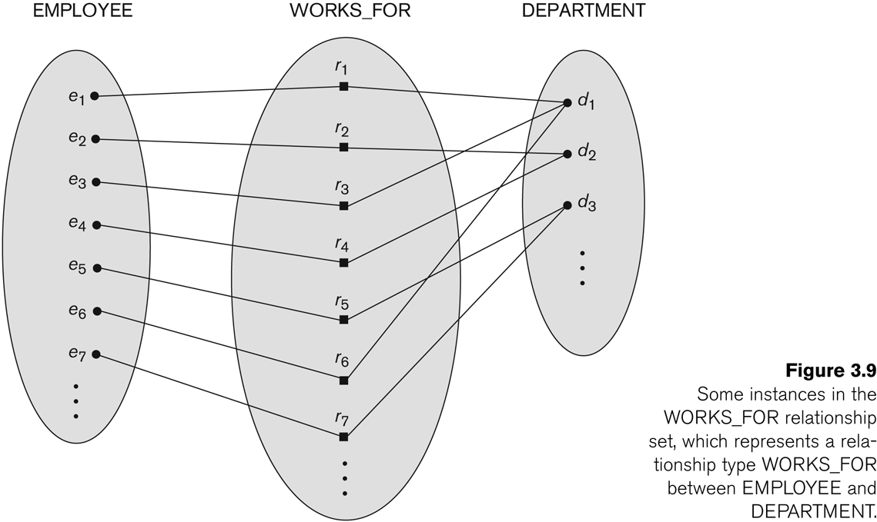
Relationship instances of the WORKS_FOR N:1 relationship between EMPLOYEE and DEPARTMENT

Slide 29
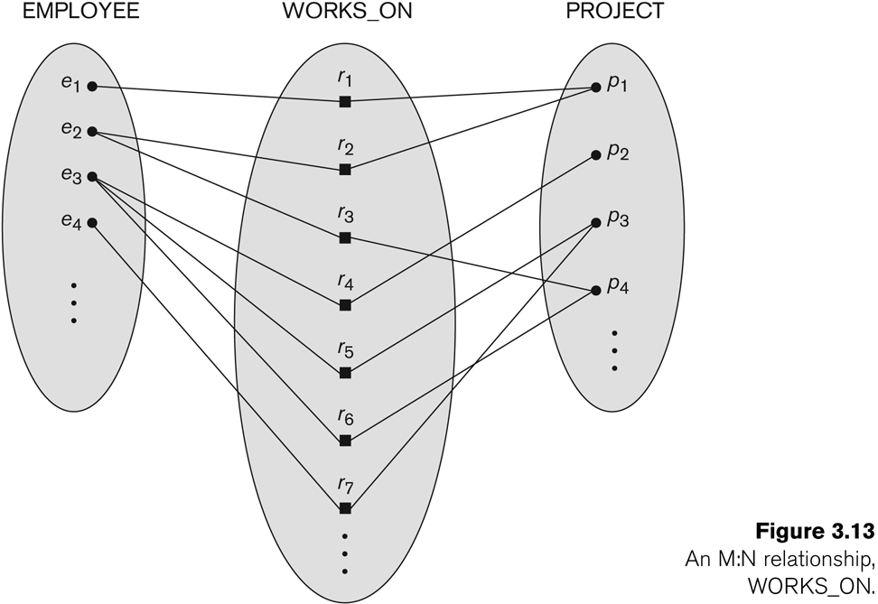
Relationship instances of the M:N WORKS_ON relationship between EMPLOYEE and PROJECT

Slide 30
Relationship type vs. relationship set
Relationship Type:
Is the schema description of a relationship
Identifies the relationship name and the participating entity types
Also identifies certain relationship constraints
Relationship Set:
The current set of relationship instances represented in the database
The current state of a relationship type

Slide 31
Degree of a relationship type
The degree of a relationship type is the number of participating entity types.
Both MANAGES and WORKS_ON are binary relationships.
The “works_for” relationship is of degree two → binary
A relationship in which for example a supplier supplies parts to a project is of degree three → ternary

Slide 32
Refining the COMPANY database schema by introducing relationships
By examining the requirements, six relationship types are identified
All are binary relationships
Listed below with their participating entity types:
WORKS_FOR (between EMPLOYEE, DEPARTMENT)
MANAGES (also between EMPLOYEE, DEPARTMENT)
CONTROLS (between DEPARTMENT, PROJECT)
WORKS_ON (between EMPLOYEE, PROJECT)
SUPERVISION (between EMPLOYEE (as supervisee), EMPLOYEE (as supervisor))
DEPENDENTS_OF (between EMPLOYEE, DEPENDENT)

Slide 33
Relationships
works for
department
employee
manages
controls
supervision
works on
project
dependents of
dependent
Notes:
TODO: Talk more about constraints.

Slide 34
Discussion on Relationship Types
In the refined design, some attributes from the initial entity types are refined into relationships:
Manager of DEPARTMENT -> MANAGES
Works_on of EMPLOYEE -> WORKS_ON
Department of EMPLOYEE -> WORKS_FOR
etc
In general, more than one relationship type can exist between the same participating entity types
MANAGES and WORKS_FOR are distinct relationship types between EMPLOYEE and DEPARTMENT
Different meanings and different relationship instances.

Slide 35
Recursive Relationship Type
A relationship type with the same participating entity type acting in distinct roles
Example: the SUPERVISION relationship
EMPLOYEE participates twice in two distinct roles:
supervisor (or boss) role
supervisee (or subordinate) role
Each relationship instance relates two distinct EMPLOYEE entities:
One employee in supervisor role
One employee in supervisee role

Slide 36
Role Names & Recursive Relationships
works for
department
employee
supervisee
supervisor
supervision
Notes:
TODO: Talk more about constraints.

Slide 37
Constraints on Relationships
Cardinality Ratio (specifies maximum participation)
One-to-one (1:1)
One-to-many (1:N) or Many-to-one (N:1)
Many-to-many (M:N)
Participation Constraint (Existence Dependency Constraint)
specifies minimum participation
zero (optional participation, not existence-dependent)
one or more (mandatory participation, existence-dependent)

Slide 38
Constraints → Cardinality Ratio
works for
1
N
department
1
employee
1
manages
controls
1
supervisee
N
supervisor
N
N
M
supervision
1
works on
1
project
dependents of
N
dependent
Notes:
TODO: Talk more about constraints.

Slide 39
Constraints → Participation
works for
1
N
department
1
employee
1
manages
controls
1
supervisee
N
supervisor
N
N
M
supervision
1
works on
1
project
dependents of
N
partial constraint
dependent
total constraint
Notes:
TODO: Talk more about constraints.

Slide 40
Attributes of Relationship types
A relationship type can have attributes:
For example, HoursPerWeek of WORKS_ON
Its value for each relationship instance describes the number of hours per week that an EMPLOYEE works on a PROJECT.
A value of HoursPerWeek depends on a particular (employee, project) combination
Most relationship attributes are used with M:N relationships
In 1:N relationships, they can be transferred to the entity type on the N-side of the relationship

Slide 41
Attributes of Relationships
works for
1
N
department
startdate
1
employee
1
manages
controls
1
supervisee
hours
N
supervisor
N
N
M
supervision
1
works on
1
project
dependents of
N
partial constraint
dependent
total constraint
Notes:
TODO: Talk more about constraints.

Slide 42
Alternative (min, max) notation for relationship structural constraints
Specified on each participation of an entity type E in a relationship type R
Specifies that each entity e in E participates in at least min and at most max relationship instances in R
Default(no constraint): min=0, max=n (signifying no limit)
Must have min≤max, min≥0, max ≥1
Derived from the knowledge of mini-world constraints
Examples:
A department has exactly one manager and an employee can manage at most one department.
Specify (0,1) for participation of EMPLOYEE in MANAGES
Specify (1,1) for participation of DEPARTMENT in MANAGES
An employee can work for exactly one department, but a department can have any number of employees.
Specify (1,1) for participation of EMPLOYEE in WORKS_FOR
Specify (1,n) for participation of DEPARTMENT in WORKS_FOR

Slide 43
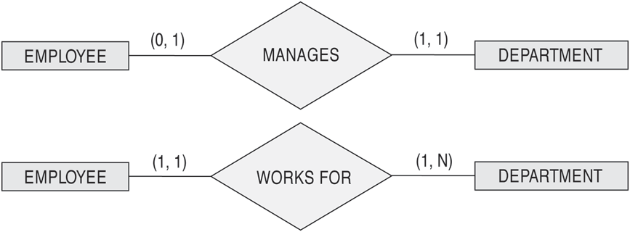
The (min,max) notation for relationship constraints
Read the min,max numbers next to the entity type and looking away from the entity type

Slide 44
Weak Entity

Slide 45
Weak Entity Types
Strong entity
key attribute
entity has a key attribute or a combination of attributes which can be used as a key.
Weak entity
No key attributes, may have a partial key
related to specific entities from another entity type in combination with some of their attribute values.
the identifying relationship will have total participation for the weak entity
identifying owner

Slide 46
number
name
location
fname
lname
1
minit
works for
N
department
address
salary
name
gender
1
number of
employees
startdate
1
ssn
employee
manages
controls
bdate
1
supervisor
N
hours
N
supervisee
M
supervision
1
works on
project
dependents of
name
number
location
N
Weak Entity
dependent
name
gender
birthdate
relationship

Slide 47
Final ER Diagram

Slide 48
Multi-Valued
Final ER-Diagram
Composite
ParticipationConstraints
Cardinality Constraints
number
name
location
fname
lname
1
minit
works for
N
department
address
salary
name
gender
1
number of
employees
startdate
1
ssn
employee
manages
controls
1
Derived
bdate
supervisor
N
hours
N
supervisee
M
supervision
1
works on
project
dependents of
name
number
location
N
Key Attribute
Weak Entity
dependent
name
gender
birthdate
relationship

Slide 49
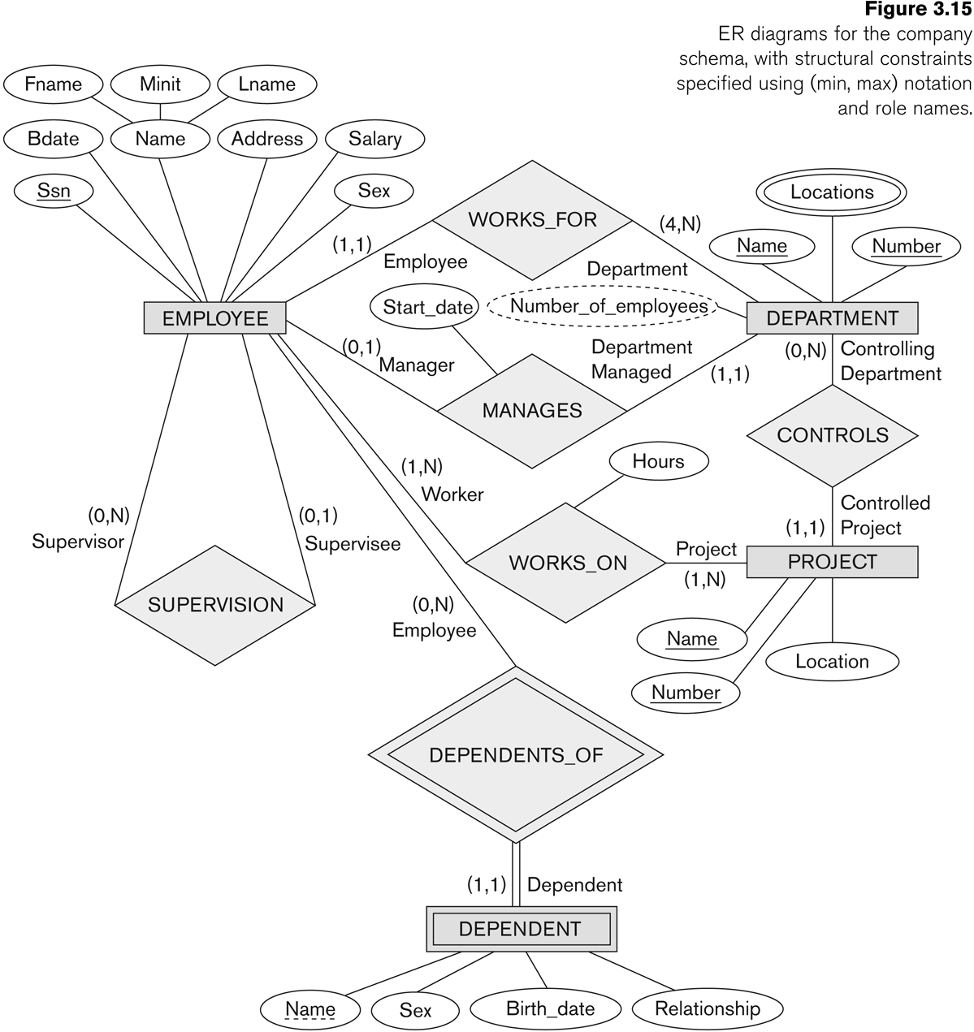
COMPANY ER Schema Diagram using (min, max) notation

Slide 50
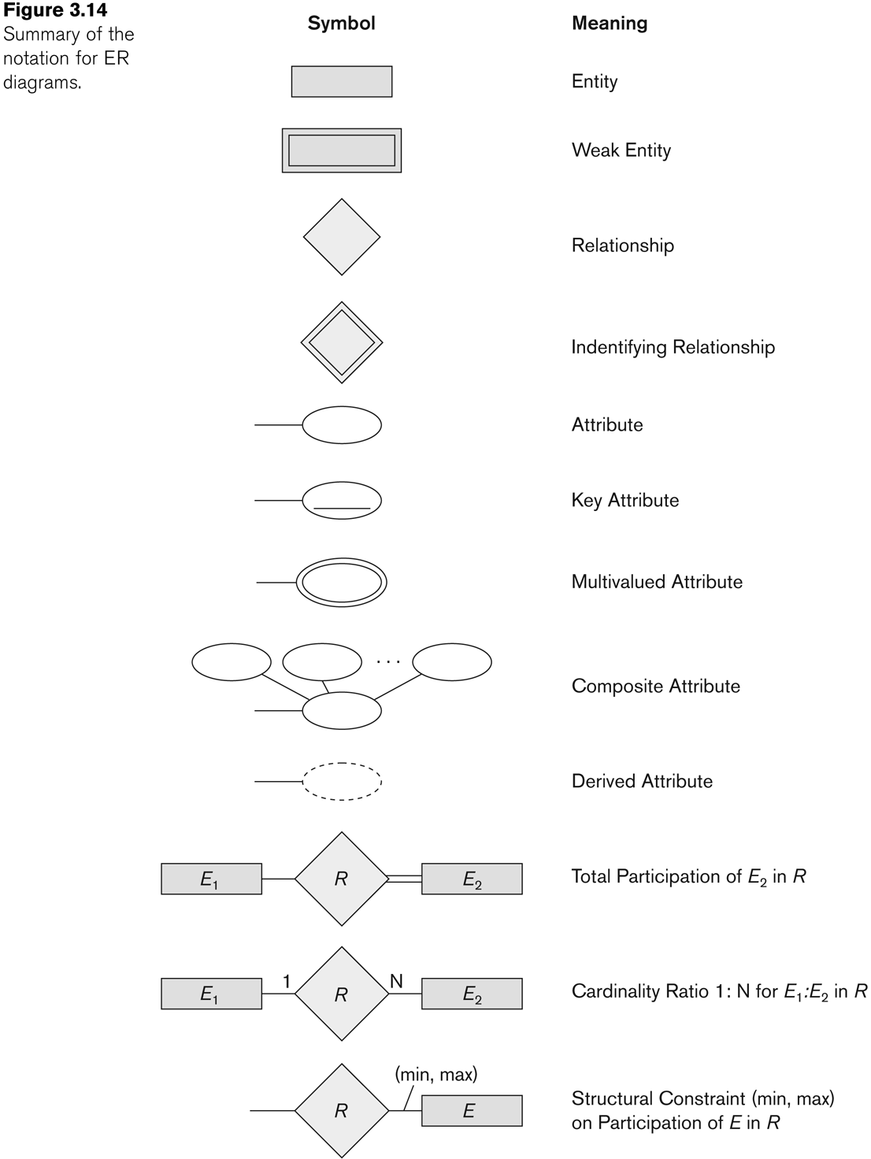
Summary of notation for ER diagrams
Summary of notation

Slide 51
Thank You

